Slide 1

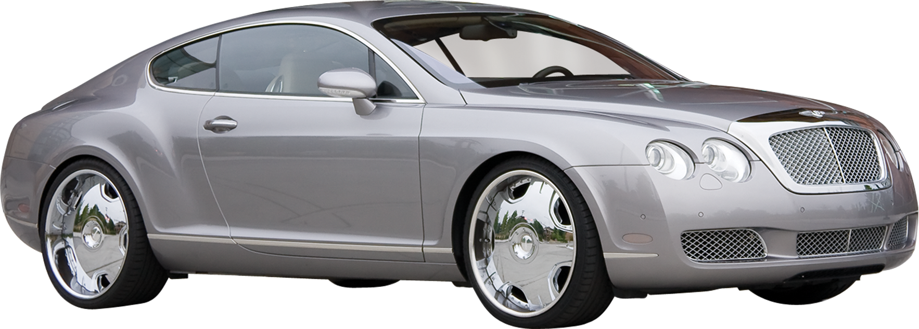
CAR PRICE PREDICTION
(Using machine learning)
Know your car's worth in seconds!

Slide 2
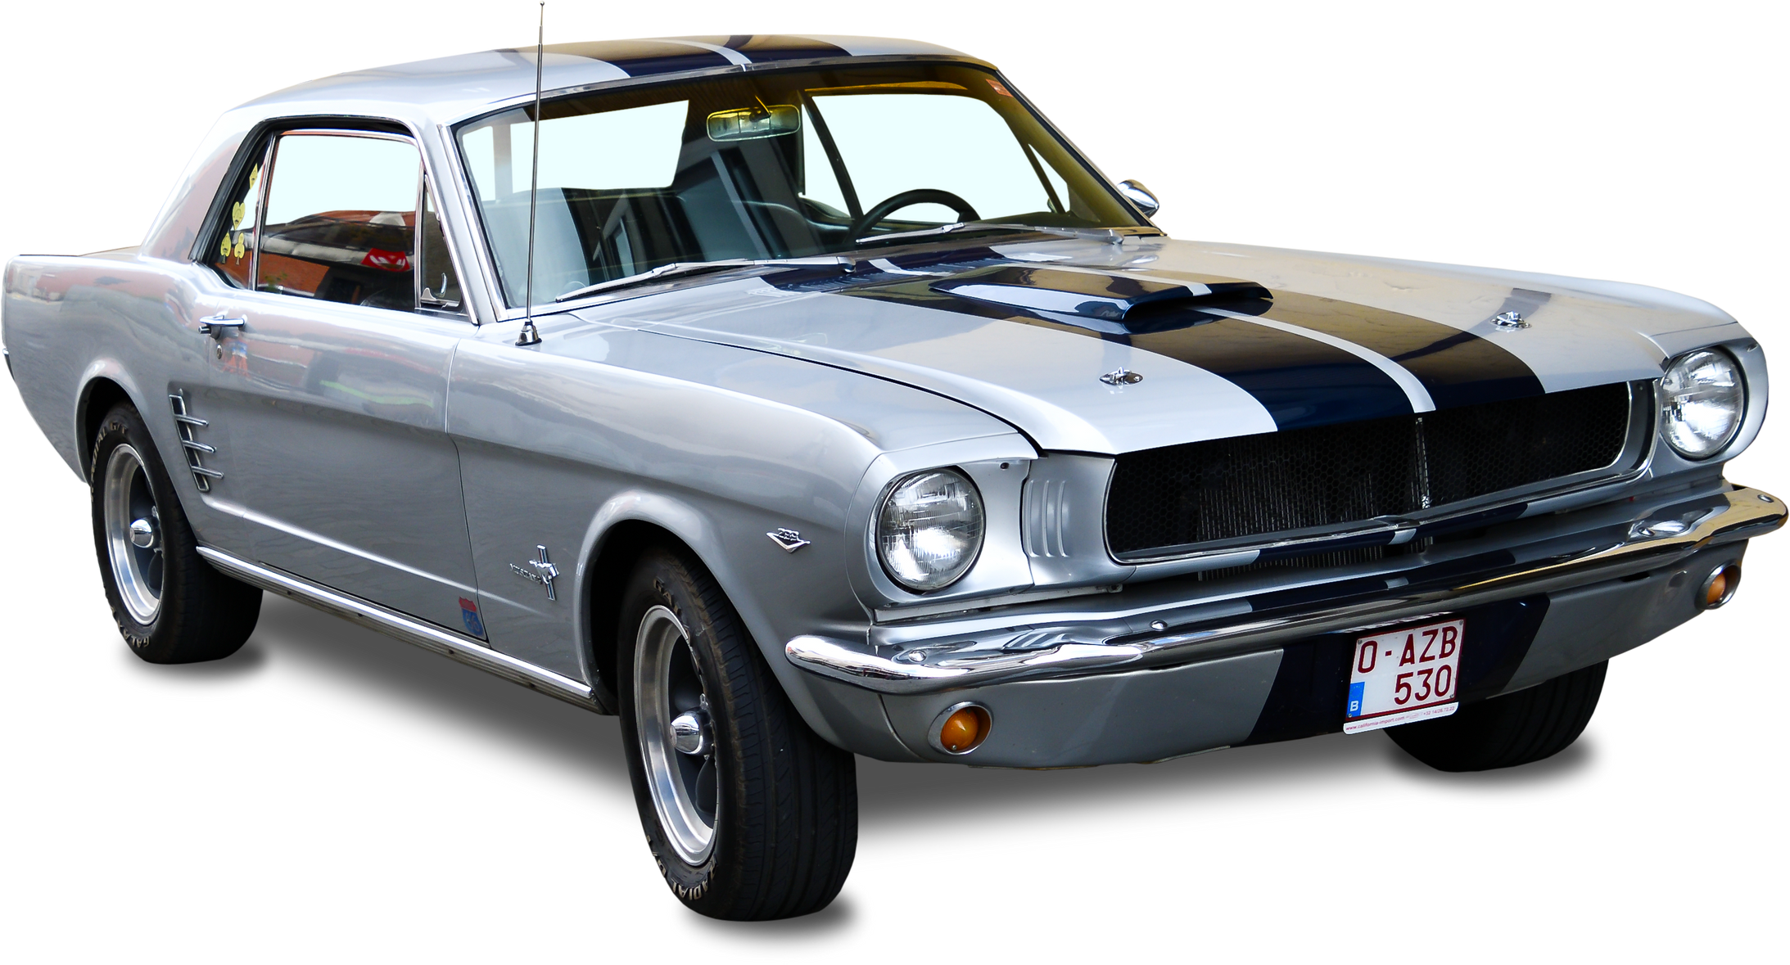

ABSTRACT
This project aims to develop an advanced machine learning model to predict used car prices with high accuracy, based on key features such as make, model, year, fuel type, transmission, kilometers driven, and more. Using Linear Regression and Random Forest algorithms, both renowned for their effectiveness in regression tasks, the model will be trained and fine-tuned to deliver precise price estimates. The solution will be built with Python libraries like Pandas and NumPy, and deployed through an interactive Streamlit web application, making it easy for customers and sales representatives to access real-time price predictions. This project strives to simplify the car pricing process, providing a reliable and user-friendly tool for better decision-making in the used car market.

Slide 3
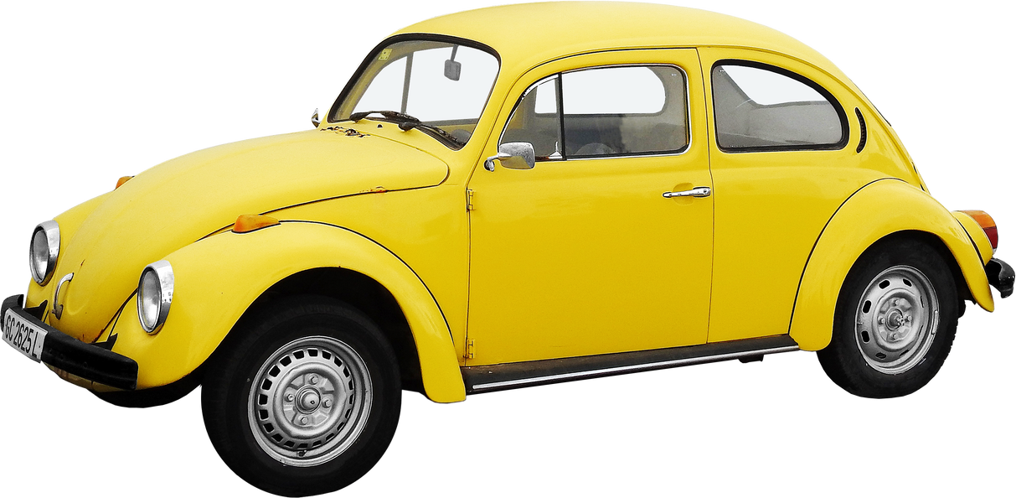
PROBLEM STATEMENT
In the context of the automotive industry, pricing used cars accurately poses a significant challenge due to the myriad of factors influencing a car's value. This project seeks to develop a machine learning model that predicts used car prices with precision. The model should be accessible via an interactive web application, facilitating easy usage by both customers and sales representatives.

Slide 4
PROPOSED SYSTEM
The proposed system predicts used car prices using machine learning models integrated into a Streamlit web app. Users input car details, which are processed by the Data Preprocessing class before being sent to the Price Prediction Model for price prediction. The predicted price is displayed to the user. Admins can train and optimize the model using historical data.

Slide 5
SCOPE
The scope of this project includes developing a machine learning-based system for predicting the prices of used cars based on key features such as make, model, year, fuel type, transmission, and kilometers driven. The project will involve creating a user-friendly Streamlit web application that allows customers and sales representatives to input car details and receive instant price predictions. Additionally, the system will support the training and optimization of the model using historical car data. The application will be deployed on a web server for easy access and real-time predictions. The system aims to streamline the used car pricing process, providing a reliable and accessible tool for better decision-making in the automotive market.

Slide 6
FEATURES
• User Input Interface:
The application provides an intuitive interface for users to input car details such as make, model, year, fuel type, transmission, kilometers driven, number of owners, and city.
• Price Prediction:
Upon receiving user inputs, the application leverages the trained Random Forest model to predict the car's price. The predicted price is displayed instantly, enhancing the user experience.
• Visualizations:
The application includes visualizations to help users understand the impact of various features on car pricing

Slide 7
FUNCTIONAL REQUIREMENTS
pandas: Used for data manipulation and analysis, such as cleaning raw data, handling missing values, and organizing the dataset for machine learning.
numpy: Provides support for numerical operations, including matrix calculations and array manipulations required for preprocessing and model training.
scikit-learn: Implements various machine learning algorithms, including Random Forest and Linear Regression. It also supports model evaluation, hyperparameter tuning, and splitting data into training and testing sets.
Matplotlib: A visualization library used for creating graphs and plots to analyze trends in car features during Exploratory Data Analysis (EDA).
Streamlit: Provides an interactive web-based interface for users to input car specifications and view the predicted price in real time.
Jupyter Notebook: Documents the end-to-end process of the project, including data cleaning, feature engineering, model training, and evaluation. It serves as a development and analysis environment.
Python 3.7+:The base programming language for developing and running the machine learning model and application.

Slide 8
NON-FUNCTIONAL REQUIREMENTS
Performance: The system must provide real-time car price predictions with minimal latency.
Scalability: The system must handle increasing numbers of users and car data without performance degradation.
Reliability: The system must ensure continuous availability and accuracy of predictions under all conditions.
Usability: The system must offer a simple, intuitive, and responsive user interface for ease of use.
Maintainability: The system must be easy to maintain, with clear structure and modular components for updates and improvements.
Accuracy: This model has 87% of accuracy.

Slide 9
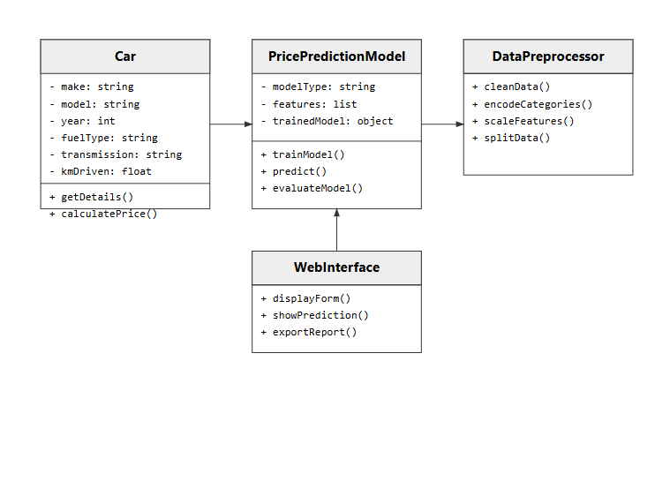
UML DIAGRAMS
CLASS DIAGRAM

Slide 10
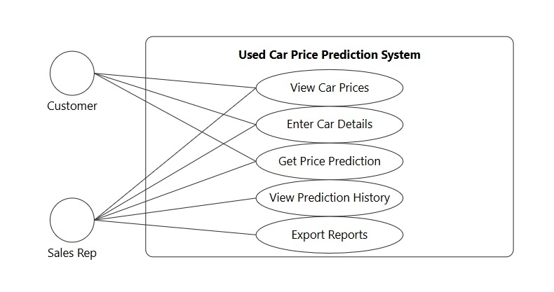
USE CASE DIAGRAM

Slide 11
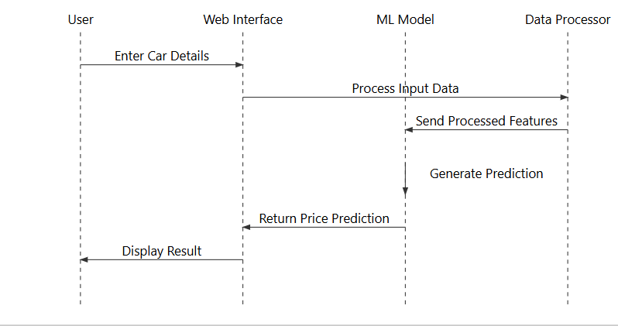
SEQUENCE DIAGRAM

Slide 12
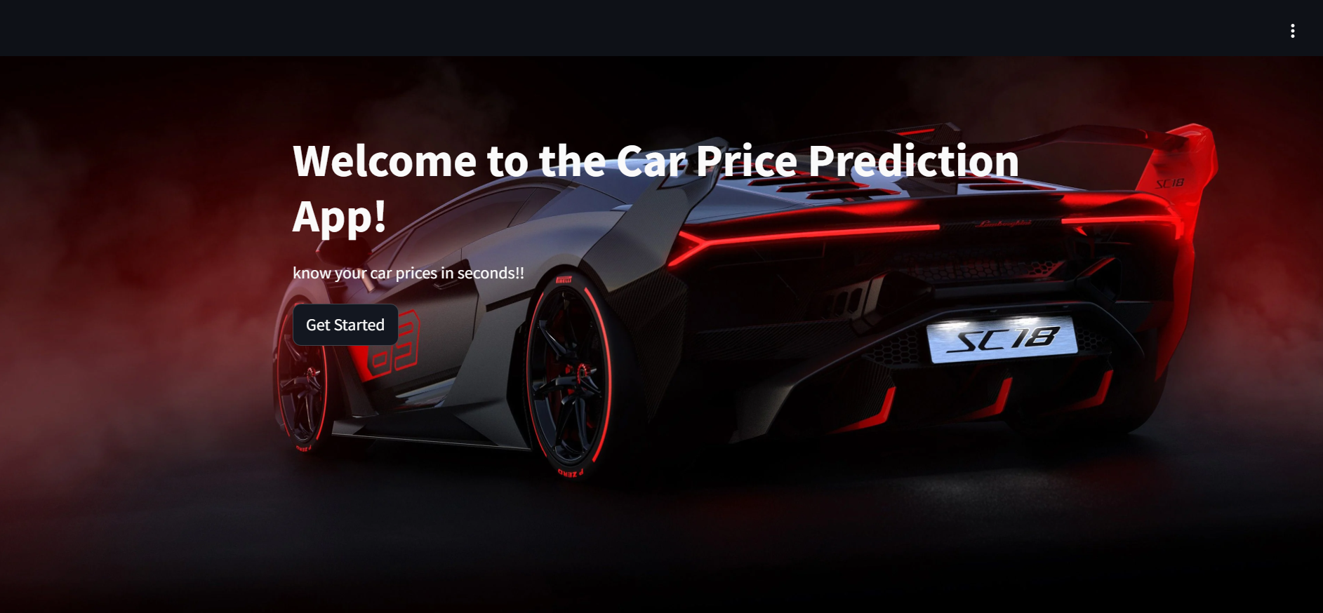
Output:

Slide 13
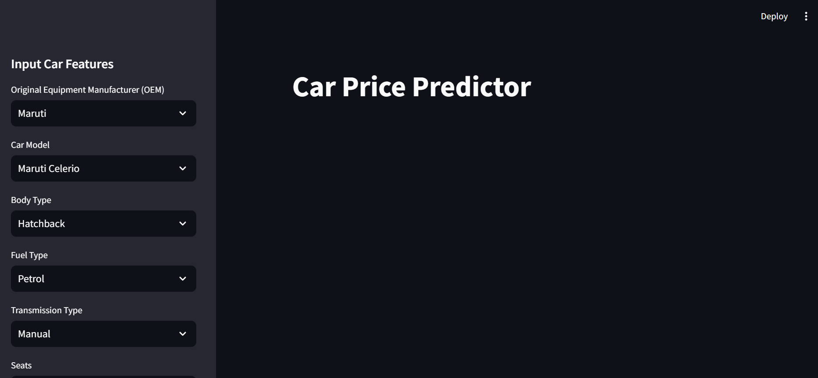

Slide 14
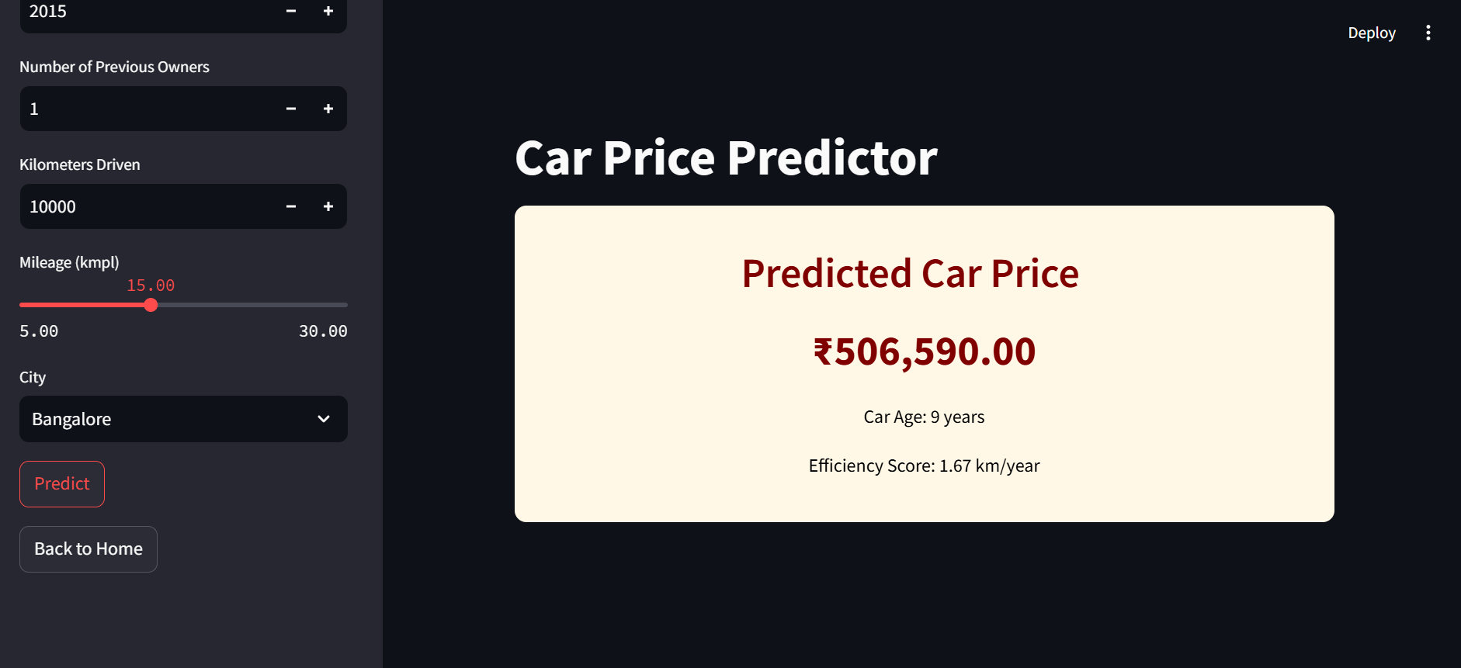

Slide 15

THANK YOU

